Slide 1


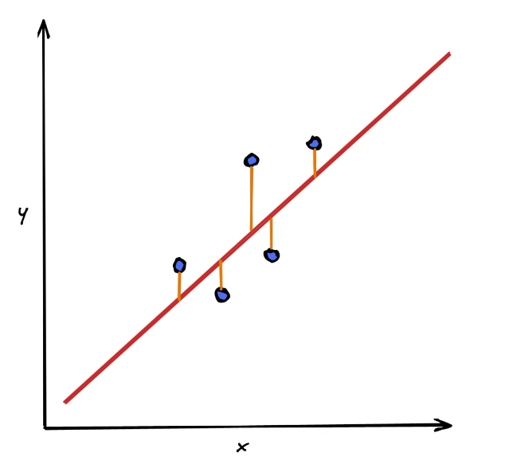
Model Evaluation Metrics for Linear Regression

Slide 2

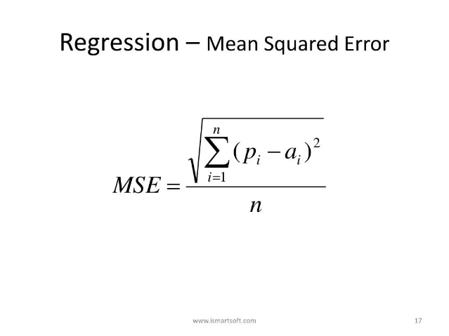
Mean Squared Error (MSE)
MSE measures the average squared difference between the predicted and actual values. It provides an indication of the overall model error, with lower values indicating better fit.

Slide 3

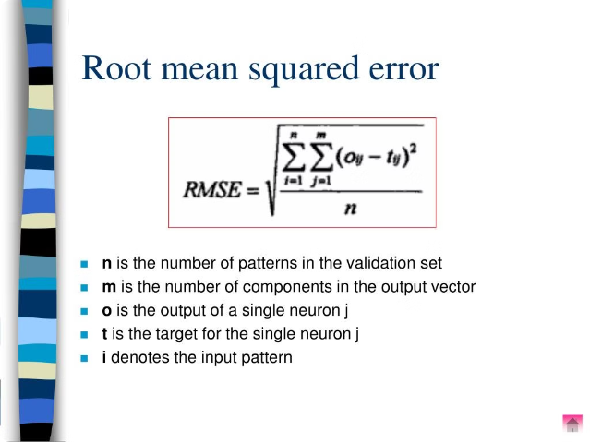
Root Mean Squared Error (RMSE)
RMSE is the square root of MSE. It gives the standard deviation of the model's errors in the same units as the original target variable, providing an easily interpretable metric.

Slide 4

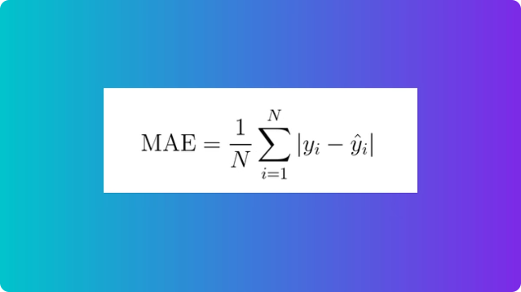
Mean Absolute Error (MAE)
MAE measures the average of the absolute differences between predicted and actual values. It is more robust to outliers than MSE and provides a sense of the typical magnitude of errors.

Slide 5

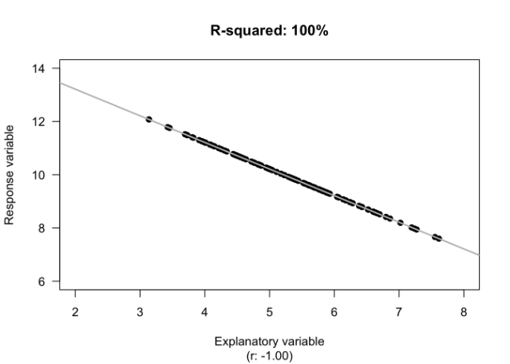
R-squared (Coefficient of Determination)
R-squared represents the proportion of the variance in the target variable that is predictable from the independent variables. It ranges from 0 to 1, with higher values indicating better model fit.

Slide 6

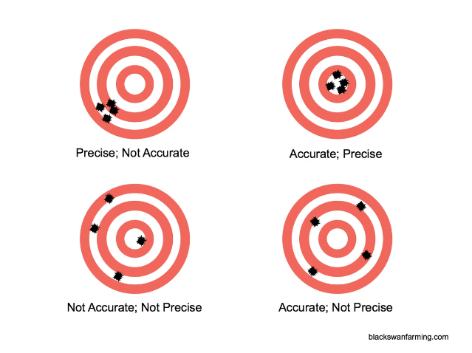
Quantifying Model Accuracy
1
MSE, RMSE, MAE
These metrics directly quantify the magnitude of a model's errors, allowing for comparison across different models or datasets.
2
R-squared
Gives the percentage of variance in the target variable that is explained by the model, providing an intuitive measure of goodness of fit.

Slide 7
Measuring Goodness of Fit
MSE, RMSE, MAE
These metrics assess how closely the model's predictions match the actual data, with lower values indicating better fit.
R-squared
Provides a statistical measure of how well the regression line approximates the real data points, with higher values denoting better fit.

Slide 8
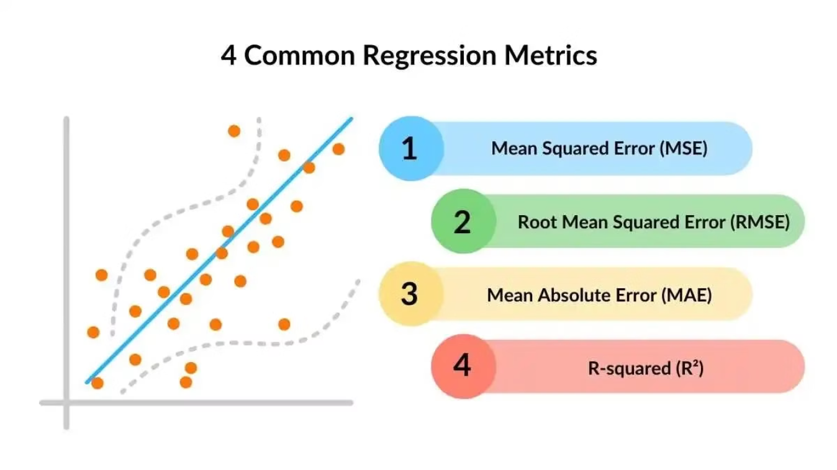
Key Metrics for Evaluating Regression Models

Slide 9


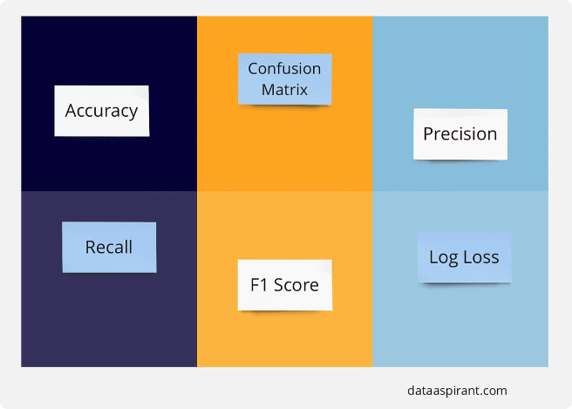


Interpreting Evaluation Metrics
Balanced Consideration
Consider multiple metrics to gain a comprehensive understanding of model performance.
Contextualize Results
Interpret metrics in the context of the problem, data, and business goals.
Establish Benchmarks
Compare metrics to industry standards or previous model versions to assess progress.

Slide 10





Applying Metrics to Model Selection
Train Models
Develop and train multiple linear regression models using the available data.
Evaluate Metrics
Calculate the MSE, RMSE, MAE, and R-squared for each model.
Compare Performance
Analyze the evaluation metrics to determine the most accurate and well-fitting model.

